Slide 1

Platform as a Service and Microsoft Azure Stack Hub
SQL Server and MySQL Server Providers in Microsoft Azure Stack Hub
This work is licensed under a Creative Commons Attribution - ShareAlike 4.0 International Public License

Slide 2
Agenda
SQL and MySQL RPs
SQL and MySQL Resource Provider concepts and overview
Architectural overview
Deployment overview

Slide 3
SQL and MySQL Resource Provider Concepts and Overview

Slide 4
What is the SQL Server Resource Provider?
The SQL Server Resource Provider provides ARM access and UI items which can be used to manage SQL server resources (to SQL Server running in IaaS)
SQL Server Resource Provider allows ARM templates and the Azure Stack Hub portals to do database CRUD operations:
Create, delete, update, and retrieve databases
Create, delete, update login settings for the databases
Create, validate, delete, update, and retrieve hosting servers
Some usage data available to operators

Slide 5
Azure Stack Hub considerations
Hosting servers must be created from a tenant subscription, created from the user portal or by using PowerShell with the appropriate sign-in. It cannot be created from the default provider subscription.
All hosting servers are billable VMs and must have licenses.
Administrator needs to manage the underlying IaaS Instance of SQL (patching, capacity planning, performance monitoring, etc.)
Any external SQL Server can be used, including SQL standalone servers, and VMs on Azure Stack Hub or Azure, as long as network connectivity can be achieved
Support for AlwaysOn Availability Groups
You can't use a SQL instance that's being used by any other consumer.

Slide 6
What is the MySQL Server Resource Provider?
The MySQL Server Resource Provider provides ARM access and UI items which can be used to manage MySQL server resources (to MySQL running in IaaS)
MySQL Server Resource Provider allows ARM templates and the Azure Stack Hub portals to do database CRUD operations:
Create, delete, update, and retrieve databases
Create, delete, update login settings for the databases
Create, validate, delete, update, and retrieve hosting servers
Some usage data available to operators

Slide 7
Azure Stack Hub considerations
Hosting servers must be created from a tenant subscription, created from the user portal or by using PowerShell with the appropriate sign-in. It cannot be created from the default provider subscription.
All hosting servers are billable VMs and must have licenses.
An Admin needs to manage the underlying IaaS Instance (same as SQL Server)
No parity with new Azure MySQL beyond basic CRUD commands
Multiple MySQL versions are supported including Community Editions, clustered versions, and licensed software
Validation of MySQL clones is pending
You can't use a MySQL instance that's being used by any other consumer.

Slide 8
Why use the SQL or MySQL Resource Provider?
Provides access to a managed SQL Server or MySQL farm through the Azure Stack Hub portal
Addresses common server farm hosting requirements including self-service access, automated provisioning, and configuration
Accessible on Azure Stack Hub and can be composed from other workloads
Provides a unified experience for consumers of compute resources on your Azure Stack Hub environment
Provides flexibility of service choice – OS and SQL/MySQL version

Slide 9
Key benefits
Provides DBaaS-like experience to tenants
It looks like PaaS to the tenant, but it’s managed as a database running on an IaaS VM
Service Providers are able to build business solutions with SQL running locally on or ‘beside’ Azure Stack Hub
Ability to use any version of SQL or MySQL
Add capacity as needed

Slide 10
Why use the SQL or MySQL Resource Provider?
Provides access to a managed SQL Server or MySQL farm through the Azure Stack Hub portal
Addresses common server farm hosting requirements including self-service access, automated provisioning, and configuration
Accessible on Azure Stack Hub and can be composed from other workloads
Provides a unified experience for consumers of compute resources on your Azure Stack Hub environment
Provides flexibility of service choice – OS to SQL/MySQL version

Slide 11
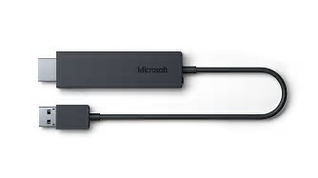




Concepts and overview – How the RP works
The SQL and MySQL RPs are adaptors
Provide DB provisioning capabilities to tenants using the Portal or API
Provides ARM access to a SQL or MySQL instance defined by the administrator
Resource Provider
A process running inside a VM that hosts the REST endpoints to provision database objects via the ARM
The RP is not in the data path, it is just involved in CRUD activities against the database instances, so a single RP can host many database servers without constricting access

Slide 12
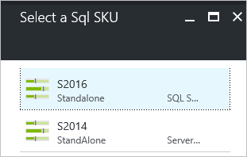
Concepts and overview - SKUs
SKUs
SKUs provide the ability to differentiate capacity to the tenants. Examples: Performance, Availability, Backup, etc.
SKUs are mostly defined by the servers hosting the databases
Admin of Azure Stack Hub can create SKUs as necessary to fit customers and business needs
Caveat: SKUs are available to all users

Slide 13
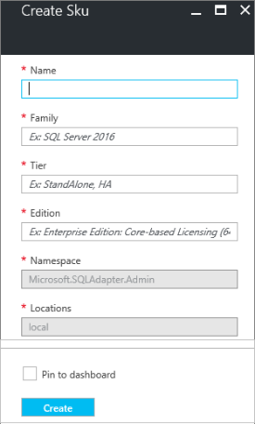
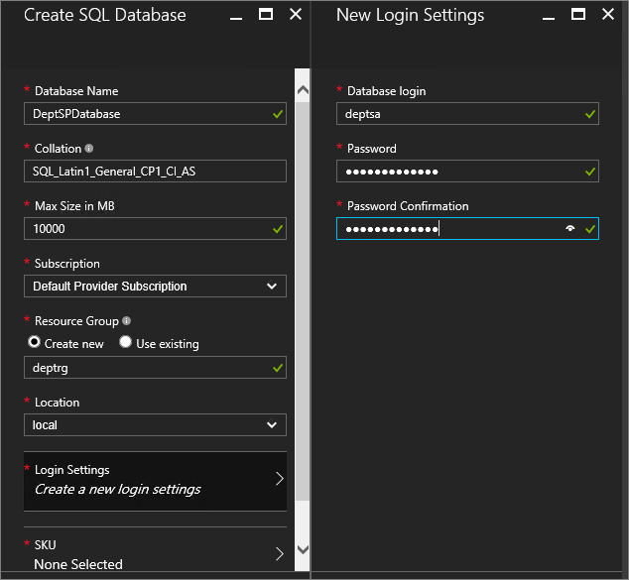
Concepts and overview – setting up database access
Quota, Plans
Admin must create plans and offers with quota, create SKUs, and associate a SKU with one or more hosting servers to allow tenants to provision databases.
Database
Create a SQL Database on a selected SKU
Delete a SQL Database

Slide 14
Architectural Overview

Slide 15
SQL and MySQL RP logical overview
SQL Tenant
Tenant space
MySQL Tenant
Admin Extensions
Tenant Extensions
Azure Resource Manager
Marketplace Tenant
SQL DB
MySQL DB
Resource Providers
SQL Admin
SQL Server RP Admin
Admin space
MySQL Admin
My SQL Server RP Admin

Slide 16

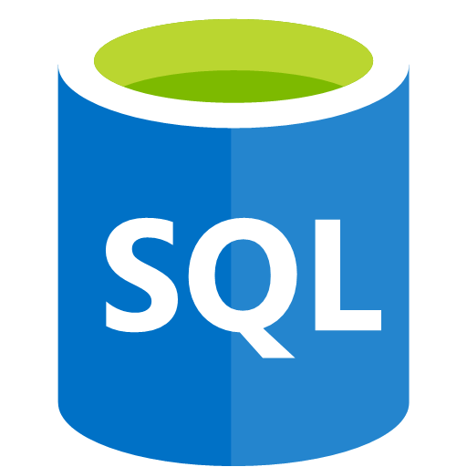
SQL and MySQL RP logical overview
SQL Tenant
Tenant space
MySQL Tenant
Admin Extensions
Tenant Extensions
Azure Resource Manager
Within Azure Stack Hub
Marketplace Tenant
SQL DB
MySQL DB
Resource Providers
Outside Azure Stack Hub
SQL Admin
SQL Server RP Admin
Admin space
MySQL Admin
My SQL Server RP Admin

Slide 17
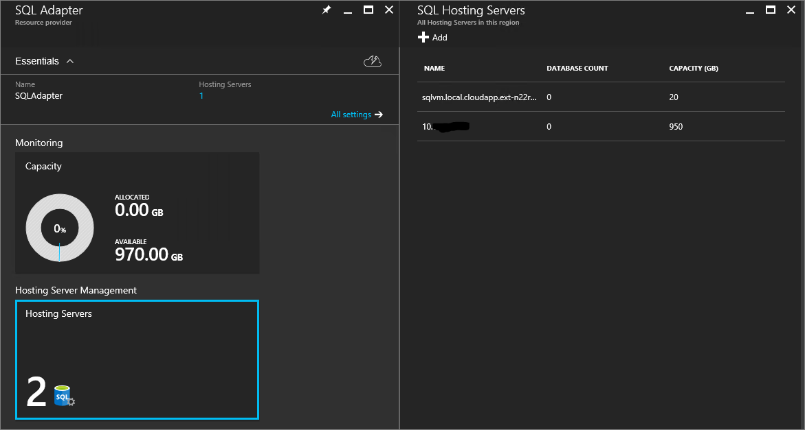
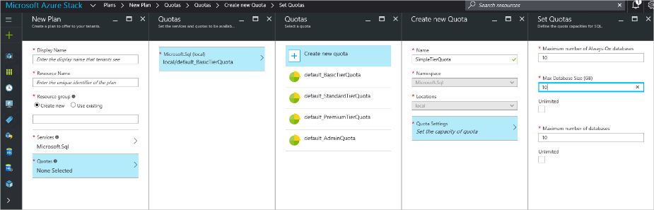
SQL and MySQL RP admin portal experience
Manage Hosting Server
Add Hosting Servers associating them with SKUs
Update the max size of the Hosting Server
Remove a Hosting Server (does not delete data)
Quota
Limit the size of a database (SQL only) and number of databases per subscription
Update default quota
Create, read, update, and delete a quota
Read all quotas

Slide 18
Expand capacity
Scale out of the RPs is achieved by adding additional hosting servers under the ARM via Portal or ARM Template
Admin can automate this process utilizing common tools such as ARM, DSC, PowerShell
Sample ARM templates are available on github

Slide 19
Deployment Overview

Slide 20
Installation
Have a computer with access to
Administrator portal
The Privileged Endpoint
ARM Management Endpoints
Download the SQL or MySQL Adapter RP packages
On Azure Stack Hub Development Kit (ASDK) installations, use the physical host.
On multi-node systems, the host must be a system that can access the Privileged Endpoint.
Run the deployment script
Azure Stack Registration completed to access Marketplace items
Add database hosting servers to the RP
Deploy SQL Server resource provider - Azure Stack Hub | Microsoft Docs

Slide 21
Deployment options (SQL)
Parameter Name | Description | Comment or Default Value
CloudAdminCredential | The credential for the cloud administrator, necessary for accessing the Privileged Endpoint. | required
AzCredential | Provide the credentials for the Azure Stack Hub Service Admin account. Use the same credentials as you used for deploying Azure Stack Hub). | required
VMLocalCredential | Define the credentials for the local administrator account of the SQL resource provider VM. | required
PrivilegedEndpoint | Provide the IP address or DNS Name of the Privileged Endpoint. | required
AzureEnvironment | The Azure environment of the service admin account which you used for deploying Azure Stack Hub. Required only for Azure AD deployments. Supported environment names are AzureCloud, AzureUSGovernment, or if using a China Azure Active Directory, AzureChinaCloud. | AzureCloud
DependencyFilesLocalPath | Your certificate PFX file must be placed in this directory as well. | optional (mandatory for multi-node)
DefaultSSLCertificatePassword | The password for the .pfx certificate | required
MaxRetryCount | Define how many times you want to retry each operation if there is a failure. | 2
RetryDuration | Define the timeout between retries, in seconds. | 120
Uninstall | Remove the resource provider and all associated resources (see notes below) | No
DebugMode | Prevents automatic cleanup on failure | No
Deploy SQL Server resource provider - Azure Stack Hub | Microsoft Docs

Slide 22
Deployment options (MySQL)
Parameter Name | Description | Comment or Default Value
CloudAdminCredential | The credential for the cloud administrator, necessary for accessing the Privleged Endpoint. | required
AzCredential | Provide the credentials for the Azure Stack Hub Service Admin account. Use the same credentials as you used for deploying Azure Stack Hub). | required
VMLocalCredential | Define the credentials for the local administrator account of the MySQL resource provider VM. | required
PrivilegedEndpoint | Provide the IP address or DNS Name of the Privileged Endpoint. | required
AzureEnvironment | The Azure environment of the service admin account which you used for deploying Azure Stack Hub. Required only for Azure AD deployments. Supported environment names are AzureCloud, AzureUSGovernment, or if using a China Azure Active Directory, AzureChinaCloud. | AzureCloud
DependencyFilesLocalPath | Path to a local share containing mysql-connector-net-6.9.9.msi. If you provide one, the certificate file must be placed in this directory as well. | optional (mandatory for multi-node)
DefaultSSLCertificatePassword | The password for the .pfx certificate | required
MaxRetryCount | Define how many times you want to retry each operation if there is a failure. | 2
RetryDuration | Define the timeout between retries, in seconds. | 120
Uninstall | Remove the resource provider and all associated resources (see notes below) | No
DebugMode | Prevents automatic cleanup on failure | No
AcceptLicense | Skips the prompt to accept the GPL License (http://www.gnu.org/licenses/old-licenses/gpl-2.0.html)
Deploy MySQL resource provider on Azure Stack Hub - Azure Stack Hub | Microsoft Docs

Slide 23
Deployment considerations
Infrastructure
Any version of MySQL can be used for hosting servers: Community, Clustered, Commercial*
Any version of SQL can be utilized – this must be managed by the admin
SQL Always On support requires SQL Server Enterprise 2016 or later for new SQL features such as automatic seeding
License and costs
Proper licensing of the hosting servers is required and license cost is not included (RP VMs are included though)
VM and storage meters to be taken into consideration

Slide 24
Deployment considerations
General
We do not have the same features for Azure Stack Hub databases as we do in public Azure PaaS, for example there is no autoscale
REST API and PowerShell do not match Azure SQL APIs
Existing ARM templates for public cloud Azure that use the Microsoft.SQL or Microsoft.MySQL namespaces will need to be modified to Microsoft.SQLAdapter and Microsoft.MySQLAdapter respectively
Samples available on the Azure Stack Hub Github Quickstart
Performance
No resource governor for SQL or MySQL
Noisy neighbors can compete for database server resources

Slide 25
Deployment considerations
Multi-tenant
All database on the same hosting server must have unique names
Database users must be unique (1:1 with databases)
SKUs are available to all Azure Stack Hub users
Maintenance
Does not participate in patches and updates, infra backup, monitoring
Operator must perform backup of RP metadata
Updates will be provided specifically for the RP

Slide 26
Removing the SQL or MySQL RP
Need copy of deployment package used to install Resource Provider Adapter
It is not necessary to manually delete these data. Removing the RP will automatically remove them:
Tenant can delete all user databases and login settings from RP (doesn't delete data)
Tenants can unregister the RP namespace from all their subscriptions
Administrator can remove the hosting servers from the SQL Resource Provider Adapter
Administrator can delete any plans that reference the SQL Resource Provider Adapter
Administrator can delete any SKUs and quotas associated to the SQL Resource Provider Adapter
Rerun the deployment script with the -Uninstall parameter, ARM endpoints, and for the service administrator account credentials

Slide 27
Maintenance

Slide 28
Maintenance
Patching and updating
The SQL/MySQL Adapter is not serviced as part of Azure Stack Hub as it is an add-on component, therefore it will be updated with a provided package from Microsoft
Updates are released corresponding to but not necessarily matching Azure Stack Hub patch and update schedule; RP must be updated at that time
Update OS and VM Windows Defender definitions
Backup/Restore/Disaster Recovery
The SQL/MySQL Adapter is not backed up as part of Azure Stack Hub BC-DR process, as it is an add-on component. Scripts will be provided to facilitate backup and restore
Updating SQL credentials
You are responsible for creating and maintaining system admin accounts on your SQL servers, the credentials must be updated using the Admin portal.
Secrets Rotation & Collect Diagnostics Logs
The Administer is responsible for rotating secrets.
The Administer can collect Diagnostics Logs in the same way as other Azure Stack Hub components, after version 1.93.

Slide 29
Helpful resources
Please refer to:
SQL RP
https://aka.ms/azurestacksqldeploy
MySQL RP
https://aka.ms/azurestackmysqldeploy

Slide 30
Questions?

Slide 32
Appendix

Slide 33
Common issues
After a successful RP deployment, sad cloud in portal while loading RP view
Have to wait for server to finish setting up, this can take some time
Refresh portal
SQL RP namespace registration for new tenant subscriptions
For any new tenant subscription, tenant needs to register the SQL RP namespace on the new subscription via PowerShell before attempting to create databases
Re-adding a SQL RP Hosting Server
When trying to add a hosting server that was previously added to SQL RP; before attempting to add, make sure that a login called SqlResourceProviderLogin does not exist on the server. If it exists, remove it or rename it before attempting the add the server to SQL RP

Slide 34
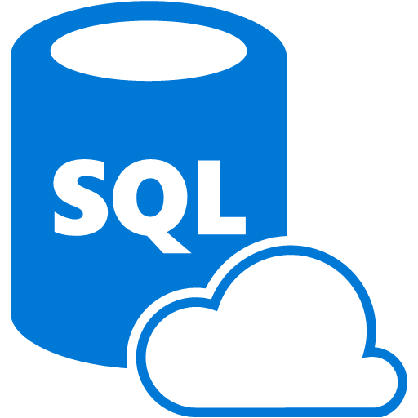
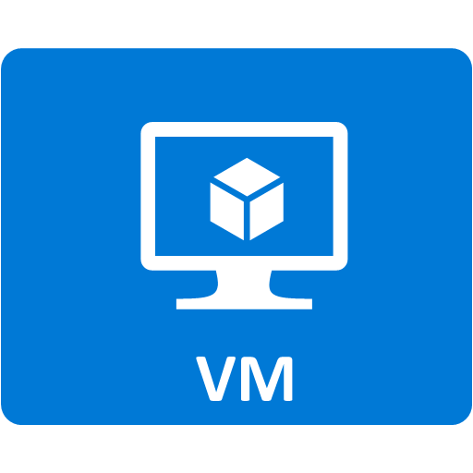


Protecting PaaS Data Stores
What is possible:
Self-service backup/restore of SQL databases
Compatible targets:
File share, storage account
Tool to be utilised:
SQL Client, etc
DB BC/DR is application dependent.
The focus is on building a process to take a consistent backup and perform a consistent restore.
A
IaaS
PaaS
Tenant space
Admin space
Azure Infrastructure

Slide 35
Resource Provider architecture
SqlTenant
SqlAdmin
Shell Site
SqlTenantExtensionForAdmin
MySqlAdmin
MySqlTenant
MySqlTenantExtensionForAdmin
Azure Resource Manager
Marketplace Tenant
Sql Database
MySql Database
SqlServerRPAdmin
SqlServerRP
Resource Providers
Admin Extensions
MySqlServerRP
Tenant Extensions
MySqlServerRPAdmin
Resource Providers
Deploy Sql/MySqlRP

Slide 36
SQL RP Admin experience
Separate Admin Portal/ARM/Core Services
As an Admin through portal
Quota: limit the size of a database and number of databases per subscription
Update default quota
Create, Read, Update and Delete a Quota
Read all Quotas
SKU: Define Family, Edition Service Tiers
Create, read, update, and delete a SKU
Read all SKUs
Hosting Server:
Add one or more hosting servers associating them with SKUs
Update the max size of the hosting Server
Remove a hosting server (does not delete data)
https://github.com/Azure/AzureStack-QuickStart-Templates/tree/master/101-sqladapter-add-hosting-server
Database:
Create a SQL database on a selected SKU
Read and delete a SQL Database
https://github.com/Azure/AzureStack-QuickStart-Templates/tree/master/101-sqladapter-create-database
Admin must create plans and offers with quota, create SKUs, and associate a SKU with one or more hosting servers to allow tenants to provision databases

Slide 37
SQL RP tenant experience
Separate Tenant Portal/ARM/Core Services
As a tenant through portal
Create databases from a choice of SKUs
Delete database
Read all the databases
Gets database connection strings that are used by applications to connect to the databases
A tenant can get additional capacity through published plan add-ons
Template-based deployments through ARM
https://github.com/Azure/AzureStack-QuickStart-Templates/tree/master/101-sqladapter-create-database

Slide 38
MySQL RP Admin experience
Separate Admin Portal/ARM/Core Services
As an Admin through portal
Quota: limit the number of database
Update default quota
Create, read, update and delete a quota
Read all Quotas
SKU: Define Family, Edition Service Tiers
Create, read, update, and delete a SKU
Read all SKUs
Not implemented yet (coming at GA)
Hosting Server:
Add one or more hosting servers (SKUs are coming)
Update the max size of hosting server
Remove a hosting server (does not delete data)
https://github.com/Azure/AzureStack-QuickStart-Templates/tree/master/mysql-standalone-server-windows
Database:
Create a database
Read and delete database
Admin must create plans and offers with quota, and add at least one hosting server to allow tenants to provision databases

Slide 39
MySQL RP tenant experience
Separate Tenant Portal/ARM/Core Services
As a tenant through portal
Create, read, and delete a database
Gets database connection strings that are used by applications to connect to the databases
A tenant can get additional capacity through published plan add-ons

Slide 40
Limitations
Not a replacement for Azure SQL DB
We do not have the features – Not a true PaaS service – not HA, no autoscale, etc.
REST API and PS not complete and undocumented at this time
Existing templates that use the Microsoft.SQL or Microsoft.MySQL namespaces will need to be modified
Performance
No resource governor for SQL at this time, possibly GA or post-GA
Noisy neighbors can compete for database server resources
Monitoring (GA or post-GA)
Without proper monitoring, this may require looking into DB server counters
Not really multi-tenant
No Windows Auth, just SQL Auth
Database names must be unique on the same hosting server
Database users must be unique (1:1 with databases)
Does not participate in PNU, infra backup, monitoring
May change over time

Slide 41
Installation
Order of operations
Insure you have a Windows Server image (2016) with appropriate .NET runtime
Use PowerShell New-Server2016VMImage
Use Syndicated Trial Image (coming soon)
Download the SQL or MySQL Adapter RP packages
Run the deployment script
Provision capacity
The script will do the following:
If necessary, download a compatible version of Azure PowerShell (we are tracking an issue here)
Create a wildcard certificate to secure communication between the resource provider and Azure Resource Manager
Download an evaluation build of SQL Server 2014 SP1 from the internet or from a local file share
Or MySQL Server (free community edition) and Connector
Upload the certificate and all other artifacts to a storage account on your Azure Stack Hub
Publish gallery package so that you can deploy SQL/MySQL databases through the gallery (Hosting Servers too)
Deploy a VM using the Windows Server image added as a pre-requisite
Register a local DNS record that maps to your resource provider VM
Register your resource provider with the local Azure Resource Manager (*Tenants must register SQLAdapter to deploy databases)
Make resources available to tenants
Add Hosting Servers
Create SKUs, quotas, offers, plans

Slide 42
Troubleshooting RP deployment
Log collection
Collect RP deployment log Ex: Logs/DeploySQLProvider.ps1_20170308-155322
Collect AzureStack Logs for Role: WAS, CRP if requested
DebugMode
This deployment option does not cleanup the RP VM after a deployment failure, allowing investigation of issues related to the VM (e.g., DSC)
ipmo C:\CloudDeployment\AzureStackDiagnostics\Microsoft.AzureStack.Diagnostics.DataCollection\Microsoft.AzureStack.Diagnostics.DataCollection.psm1 -force
Get-AzureStackLogs -OutputPath "<Enter output Path>" -FilterByRole @('WAS','CRP')

Slide 43
Common issues
After a successful RP deployment, sad cloud in portal while loading RP view
Have to wait for server to finish setting up, this can take some time
Refresh portal
SQL RP namespace registration for new tenant subscriptions
For any new tenant subscription, tenant needs to register the SQL RP namespace on the new subscription via PowerShell before attempting to create databases
Re-adding a SQL RP Hosting Server
When trying to add a hosting server that was previously added to SQL RP; before attempting to add, make sure that a login called Sql ResourceProviderLogin does not exist on the server. If it exists, remove it or rename it before attempting the add the server to SQL RP

Slide 44
Common Issues cont.
Conflicting Azure PS modules
May need to manually install modules
Close all open PowerShell windows
Install-Module AzureRm -RequiredVersion ‘1.2.9’ -Force -AllowClobber
Install-Module AzureStack -RequiredVersion ‘1.2.9’ -Force –AllowClobber
Spurious failure messages when it really succeeds
Reties usually work, get past “Conflict” message
Can’t register
Still investigating, this looks like an inability to get correct status
We give up after 20 minutes and retry

